Slide 1
Summary: Processing Options
Austenite (γ)
slow
moderate
rapid
cool
cool
quench
Pearlite
Bainite
Martensite
(α + Fe₃C layers + a
(α + Fe₃C plates/needles)
(BCT phase
proeutectoid phase)
diffusionless
transformation)
martensite
reheat
temp. martensite
bainite
Tempered
Strength
fine pearlite
Ductility
Martensite
coarse pearlite
(α + very fine
spheroidite
Fe₃C particles)
General Trends

Slide 2
Chapter 11: Metal Alloys
Applications and Processing
ISSUES TO ADDRESS...
• How are metal alloys classified and how are they used?
• What are some of the common fabrication techniques?
• How do properties vary throughout a piece of material
that has been quenched, for example?
• How can properties be modified by post heat treatment?

Slide 3

Taxonomy of Metals
Metal
Alloys
Ferrous
Nonferrous
Steels
Cast Irons
Steels
Cast Irons
Cu
Al
Mg
Ti
<1.4 wt% C
<1.4wt%C
3-4.5 wt% C
3-4.5
wt%C
T(°C)
microstructure:
1600
ferrite, graphite
δ
cementite
1400
L
γ
+L
1200
γ
1148°C
L+Fe₃C
austenite
Eutectic:
1000
4.30
α
γ
+Fe₃C
α
800
+
γ
727°C
Fe
3
C
ferrite
Eutectoid:
cementite
600
0.76
α
+Fe₃C
400
0
1
2
3
4
5
6
6.7
(Fe)
C_{o} , wt% C

Slide 4
Steels
Low Alloy
High Alloy
low carbon
Med carbon
high carbon
<0.25 wt% C
0.25-0.6 wt% C
0.6-1.4 wt% C
Name
plain
HSLA
plain
heat
plain
tool
treatable
stainless
Additions
none
Cr,V
none
Cr, Ni
none
Cr, V,
Cr, Ni, Mo
Ni, Mo
Mo
Mo, W
Example
1010
4310
1040
43
40
1095
4190
304
Hardenability
0
+
+
++
++
+++
0
TS
-
0
+
++
+
++
0
EL
+
+
0
-
-
--
++
Uses
auto
bridges
crank
pistons
wear
drills
high T
struc.
towers
shafts
gears
applic.
saws
applic.
sheet
press.
bolts
wear
dies
turbines
vessels
hammers
applic.
furnaces
blades
V. corros.
increasing strength, cost, decreasing ductility
resistant

Slide 5
Refinement of Iron from Ore
Coke
Iron Ore
Limestone
BLAST FURNACE
heat generation
gas
C
+
O₂
→
CO₂
refractory
vessel
reduction of iron ore to metal
layers of coke
CO₂
+
C
→
2CO
and iron ore
3CO +
Fe₂O₃
→
2Fe
+3CO₂
air
purification
slag
Molten iron
CaCO₃
→
CaO+CO₂
CaO + SiO₂ + Al₂O₃
→
slag
Pig Iron: 3.5-4.5%C (near eutectic)

Slide 6
Bessemer process: reduce carbon content by blowing air on liquid iron
Oxidation reactions release heat, remove carbon
Ladle tipped after conversion to separate from slag (floats)

Slide 7
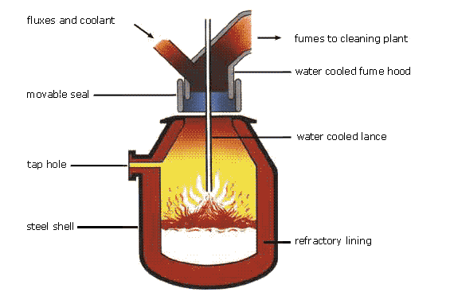
Making steel: Basic Oxygen Furnace

Slide 8
Ferrous Alloys
Iron containing – Steels - cast irons
Nomenclature AISI & SAE
10xx Plain Carbon Steels
11xx Plain Carbon Steels (resulfurized for machinability)
15xx Mn (10 ~ 20%)
40xx Mo (0.20 ~ 0.30%)
43xx Ni (1.65 - 2.00%), Cr (0.4 - 0.90%), Mo (0.2 - 0.3%)
44xx Mo (0.5%)
where xx is wt% C x 100
example: 1060 steel – plain carbon steel with 0.60 wt% C
Stainless Steel -- >11% Cr

Slide 9
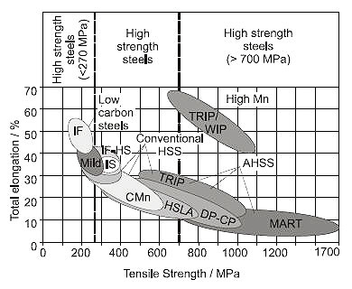
Steels
IF: interstitial free
DP: dual-phase
CP: complex phase
TRIP: transformation induced plasticity
TWIP: twinning induced plasticity
(17-20% Mn)
HSLA: high strength low alloy
MART: martensitic
Low strength
steels
(<270 MPa)
Medium strength
steels
High strength
steels
(>700 MPa)

Slide 10
Oxide-Dispersion-Strengthened (ODS) Steels
Combine fine powders of steel alloys with nanoscale oxide (ceramic) particles
Compact and extrude at high temperature, roll into bars, plates, or tubes.
Have both high strength and high ductility, of interest for most demanding applications such as nuclear reactors (also radiation-damage tolerant).

Slide 11
Cast Iron
Ferrous alloys with > 2.1 wt% C
  more commonly 3 - 4.5 wt%C
low melting (also brittle) so easiest to cast
Cementite is metastable, it decomposes to ferrite + graphite: Fe₃C → 3 Fe (α) + C (graphite)
  this is generally a slow process
  graphite stability also enhanced by >1wt% silicon
Notes:
So phase diagram for this system is different (Fig 12.4)

Slide 12
Fe-C True Equilibrium Diagram
T(°C)
1600
Graphite formation promoted by
Si > 1 wt%
slow cooling
1400
L
Liquid +
Graphite
γ
+L
1200
γ
1153°C
Austenite
4.2 wt% C
1000
α + γ
γ + Graphite
800
740°C
600
0.65
α + Graphite
Adapted from Fig. 11.2,Callister 7e. (Fig. 11.2 adapted from Binary Alloy Phase Diagrams, 2nd ed.,
Vol. 1, T.B. Massalski (Ed.-in-Chief), ASM International, Materials Park, OH, 1990.)
400
0
1
2
3
4
90
100
(Fe)
C_{o} , wt% C
Notes:
Cast irons have graphite

Slide 13
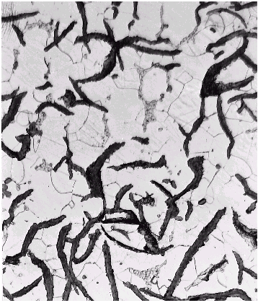
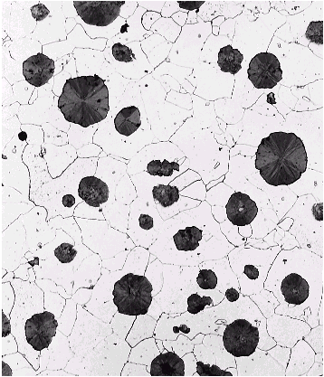
Types of Cast Iron
Gray iron
graphite flakes
weak & brittle under tension
stronger under compression
excellent vibrational dampening
wear resistant
Ductile or nodular iron
add Mg or Ce
graphite in nodules not flakes
matrix often pearlite - better ductility
Adapted from Fig. 11.3(a) & (b), Callister 7e.

Slide 14
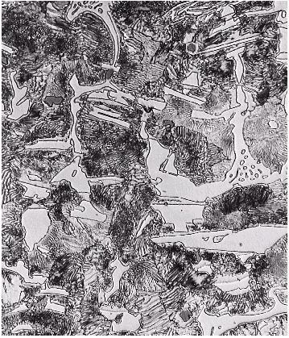
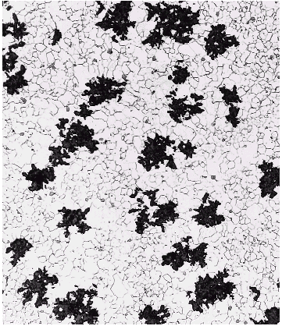
Types of Cast Iron
White iron
<1wt% Si so harder but brittle
more cementite
wear resistant applications, also as precursor for malleable
Malleable iron
heat treat white iron at 800-900ºC
graphite in rosettes
more ductile
Adapted from Fig. 11.3(c) & (d), Callister 7e.

Slide 15
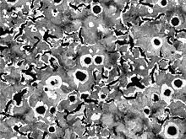
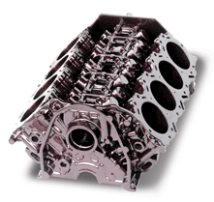
CGI: Compacted Graphite Iron
graphite has a wormlike (vermicular) shape
leads to higher strength and ductility

Slide 16
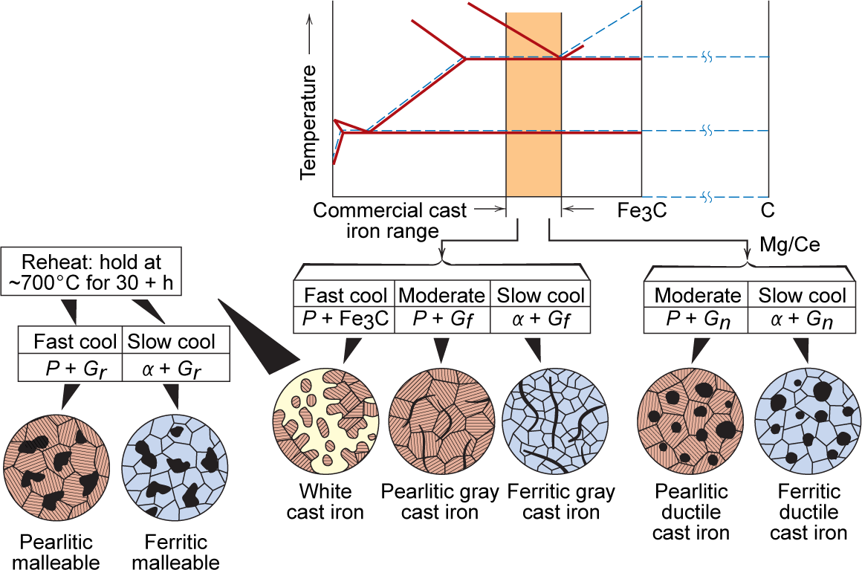
Production of Cast Iron
Adapted from Fig.11.5, Callister 7e.

Slide 17
Limitations of Ferrous Alloys
  Relatively high density
  Relatively low conductivity
  Poor corrosion resistance
Stainless Steels
  Need to add more than 11% Cr, sometimes Ni, Mo
  Martensitic (BCT)
    Austenitic (FCC)
    Ferritic (BCC)
    In Fe, BCC and BCT are magnetic but FCC is not

Slide 18
Nonferrous Alloys
• Cu Alloys
• Al Alloys
Brass: Zn is subst. impurity
-lower
ρ
: 2.7g/cm³
(costume jewelry, coins,
-Cu, Mg, Si, Mn, Zn additions
corrosion resistant)
-solid sol. or precip.
Bronze
: Sn, Al, Si, Ni are
strengthened (struct.
subst. impurity
aircraft parts
(bushings, landing
& packaging)
gear)
NonFerrous
• Mg Alloys
Cu-Be
:
-very low
ρ
: 1.7g/cm³
Alloys
precip. hardened
-ignites easily
for strength
-
aircraft, missiles
• Ti Alloys
-lower
ρ
: 4.5g/cm³
• Refractory metals
-high melting T
vs 7.9 for steel
• Noble metals
-Nb, Mo, W, Ta
-reactive at high T
-Ag, Au, Pt
-
space applic.
-
oxid./corr. resistant
Based on discussion and data provided in Section 11.3, Callister 7e.

Slide 19
Metal Fabrication
How do we fabricate metals?
  Blacksmith - hammer (forged)
  Molding - cast
Forming Operations
  Rough stock formed to final shape
  Hot working vs. Cold working
  • T high enough for • well below T_{m} recrystallization • work hardening
  • Larger deformations • smaller deformations

Slide 20
Metal Fabrication Methods - I
FORMING
CASTING
JOINING
• Forging (Hammering; Stamping)
(wrenches, crankshafts)
• Rolling (Hot or Cold Rolling)
(I-beams, rails, sheet & plate)
force
die
roll
A
often at
elev. T
d
A
o
blank
A
d
A
o
roll
Adapted from Fig. 11.8, Callister 7e.
force
• Drawing
(rods, wire, tubing)
• Extrusion
(rods, tubing)
die
A
o
A
d
container
die holder
A
tensile
force
o
force
ram
billet
extrusion
A
d
die
die
container
die must be well lubricated & clean
ductile metals, e.g. Cu, Al (hot)

Slide 21
Metal Fabrication Methods - II
FORMING
CASTING
JOINING
Casting- mold is filled with metal
  metal melted in furnace, perhaps alloying elements added. Then cast in a mold
  most common, cheapest method
  gives good production of shapes
  weaker products, internal defects
  good option for brittle materials

Slide 22
Metal Fabrication Methods - II
FORMING
CASTING
JOINING
• Sand Casting
(large parts, e.g.,
auto engine blocks)
trying to hold something that is hot
what will withstand >1600ºC?
cheap - easy to mold => sand!!!
pack sand around form (pattern) of desired shape
Sand
Sand
molten metal

Slide 23
Metal Fabrication Methods - II
FORMING
CASTING
JOINING
• Sand Casting
(large parts, e.g.,
auto engine blocks)
Investment Casting
pattern is made from paraffin.
mold made by encasing in
plaster of paris
melt the wax & the hollow mold
is left
pour in metal
Sand
Sand
molten metal
• Investment Casting
(low volume, complex shapes
e.g., jewelry, turbine blades)
plaster
die formed
around wax
prototype
wax

Slide 24
Metal Fabrication Methods - II
FORMING
CASTING
JOINING
• Sand Casting
(large parts, e.g.,
auto engine blocks)
• Die Casting
(high volume, low T alloys)
Sand
Sand
molten metal
• Continuous Casting
(simple slab shapes)
• Investment Casting
(low volume, complex shapes
e.g., jewelry, turbine blades)
molten
plaster
die formed
around wax
prototype
solidified
wax

Slide 25
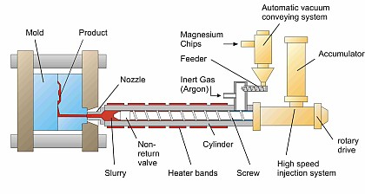

Thixomolding: Magnesium
Lightweight, high precision
electronic components (Mg)
Done from solid + liquid region of the phase diagram
http://www.thixomat.com/

Slide 26
Metal Fabrication Methods - III
FORMING
CASTING
JOINING
• Powder Metallurgy
(materials w/low ductility)
• Welding
(when one large part is
impractical)
pressure
filler metal (melted)
base
metal (melted)
fused base metal
heat
heat affected zone
area
unaffected
unaffected
contact
piece 1
piece 2
Adapted from Fig. 11.9, Callister 7e.
(Fig. 11.9 from Iron Castings Handbook, C.F. Walton and T.J. Opar (Ed.), 1981.)
densify
• Heat affected zone:
(region in which the
microstructure has been
changed).
point contact
densification
at low T
by diffusion at
higher T

Slide 27
Thermal Processing of Metals
Annealing: Heat to Tanneal, then cool slowly.
•
Stress Relief: Reduce
•
Spheroidize
(steels):
stress caused by:
Make very soft steels for
-plastic deformation
good machining. Heat just
-non-uniform cooling
below T_{E} & hold for
-phase transform.
15-25 h.
Types of
•
Full Anneal
(steels):
Make soft steels for
Annealing
good forming by heating
to get
γ
, then cool in
•
Process Anneal:
furnace to get coarse P.
Negate effect of
•
Normalize
(steels):
cold working by
(recovery/
Deform steel with large
recrystallization)
grains, then normalize
to make grains small.
Based on discussion in Section 11.7, Callister 7e.

Slide 28
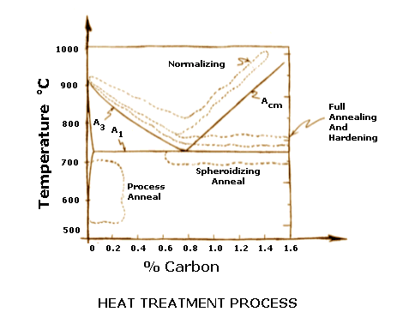
Annealing Temperatures
www.efunda.com

Slide 29
Heat Treatments
800
Austenite (stable)
Slow cooling
T(°C)
T_{E}
A
Quenching
P
600
Tempered Martensite
B
400
A
Adapted from Fig. 10.22, Callister 7e.
100%
0%
50%
200
M + A
0%
M + A
50%
a)
90%
b)
c)
10
-1
10
10
3
10
5
time (s)

Slide 30
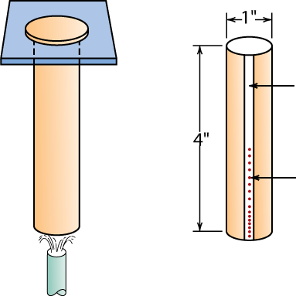
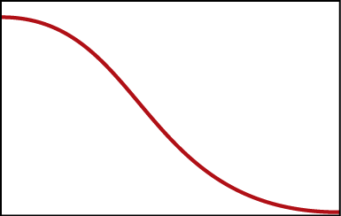
Hardenability--Steels
• Ability to form martensite
• Jominy end quench test to measure hardenability.
Adapted from Fig. 11.11, Callister 7e. (Fig. 11.11 adapted from A.G. Guy, Essentials of Materials Science, McGraw-Hill Book Company, New York, 1978.)
flat ground
specimen
(heated to γ
phase field)
Rockwell C
hardness tests
24°C water
• Hardness versus distance from the quenched end.
Hardness, HRC
Adapted from Fig. 11.12, Callister 7e.
Distance from quenched end

Slide 31
Why Hardness Changes W/Position
• The cooling rate varies with position.
60
40
Hardness, HRC
20
0
1
2
3
distance from quenched end (in)
T(°C)
0%
600
P
100%
→
Adapted from Fig. 11.13, Callister 7e.
(Fig. 11.13 adapted from H. Boyer (Ed.) Atlas of Isothermal Transformation and Cooling Transformation Diagrams, American Society for Metals, 1977, p. 376.)
A
400
M(start)
200
A
→
M
0
M(finish)
Pearlite
Martensite
Fine Pearlite
Martensite + Pearlite
0.1
1
10
100
1000
Time (s)

Slide 32

Hardenability vs Alloy Composition
• Jominy end quench
results, C = 0.4 wt% C
100
10
3
2
Cooling rate (°C/s)
60
100
4340
80
%M
Hardness, HRC
50
40
4140
Adapted from Fig. 11.14, Callister 7e.
(Fig. 11.14 adapted from figure furnished courtesy Republic Steel Corporation.)
8640
1040
5140
20
0
10
20
30
40
50
Distance from quenched end (mm)
• "Alloy Steels"
(4140, 4340, 5140, 8640)
--contain Ni, Cr, Mo
(0.2 to 2wt%)
--these elements shift
the "nose".
--martensite is easier
to form.
800
T(°C)
T_{E}
600
shift from
A
B
A to B due
400
to alloying
200
M(start)
M(90%)
0
-1
3
5
Time (s)
10
10
10
10

Slide 33
Quenching Medium & Geometry
• Effect of quenching medium:
Medium
air
oil
water
Severity of Quench
low
moderate
high
Hardness
low
moderate
high
• Effect of geometry:
When surface-to-volume ratio increases:
--cooling rate increases
--hardness increases
Position
center
surface
Cooling rate
low
high
Hardness
low
high

Slide 34
Precipitation Hardening
• Particles impede dislocations.
• Ex: Al-Cu system
• Procedure:
700
T(°C)
L
CuAl₂
600
α
α+L
--Pt A: solution heat treat
(get α solid solution)
θ+L
A
500
θ
--Pt B: quench to room temp.
α+θ
400
C
--Pt C: reheat to nucleate
small θ crystals within
α crystals.
300
(Al)
0
B
10
20
30
40
50
wt% Cu
Other precipitation
systems:
• Cu-Be
• Cu-Sn
• Mg-Al
composition range
needed for precipitation hardening
Adapted from Fig. 11.24, Callister 7e. (Fig. 11.24 adapted from J.L. Murray, International Metals Review 30, p.5, 1985.)
Temp.
Pt A (sol’n heat treat)
Pt C (precipitate θ)
Adapted from Fig. 11.22, Callister 7e.
Time
Pt B

Slide 35

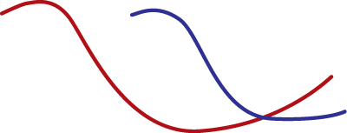
Precipitate Effect on TS, %EL
• 2014 Al Alloy:
• TS peaks with
precipitation time.
• Increasing T accelerates
process.
• %EL reaches minimum
with precipitation time.
many small
“aged”
precipitates
non-equil.
30
solid solution
fewer large
400
precipitates
“overaged”
20
300
tensile strength (MPa)
%EL (2 in sample)
149°C
10
200
204°C
149
°C
204°C
100
0
1min
1h
1day
1mo
1yr
1min
1h
1day
1mo
1yr
precipitation heat treat time
precipitation heat treat time
Adapted from Fig. 11.27 (a) and (b), Callister 7e. (Fig. 11.27 adapted from Metals Handbook: Properties and Selection: Nonferrous Alloys and Pure Metals, Vol. 2, 9th ed., H. Baker (Managing Ed.), American Society for Metals, 1979. p. 41.)

Slide 36
Summary
• Steels: increase TS, Hardness (and cost) by adding
--C (low alloy steels)
--Cr, V, Ni, Mo, W (high alloy steels)
--ductility usually decreases w/additions.
• Non-ferrous:
--Cu, Al, Ti, Mg, Refractory, and noble metals.
• Fabrication techniques:
--forming, casting, joining.
• Hardenability
--increases with alloy content.
• Precipitation hardening
--effective means to increase strength in
Al, Cu, and Mg alloys.

